Slide 1
Review and Overview
LLO 8200, Introduction to Data Science
Vanderbilt University

Slide 2
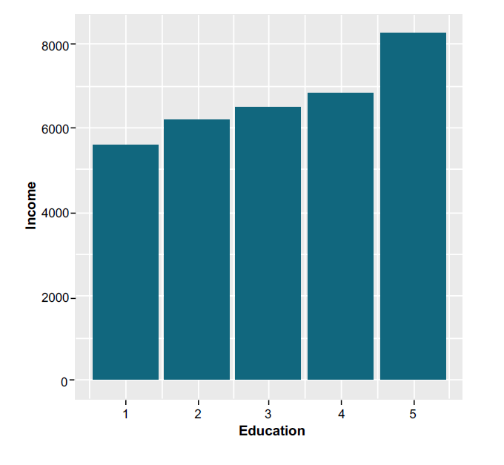
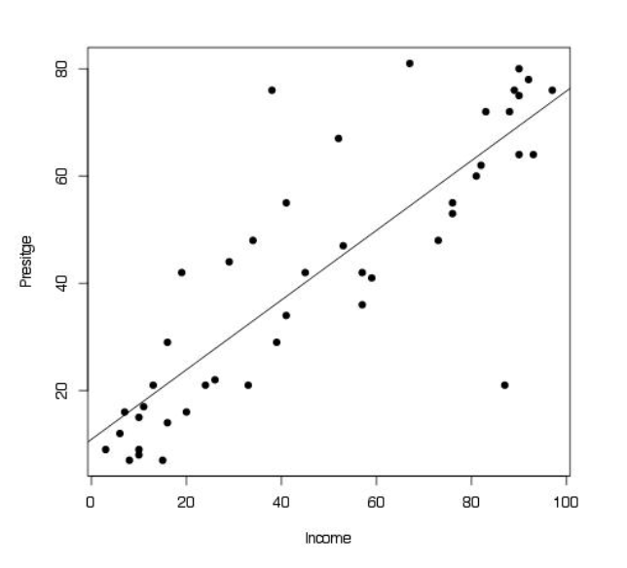
Review: Weeks 2 and 5
Conditional mean
Linear regression

Slide 3
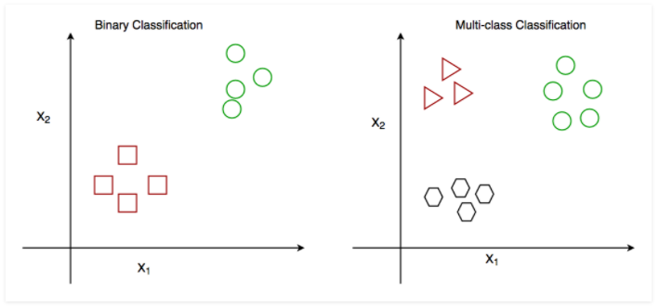
Module 8: Classification
An algorithm for describing (and predicting) the relationship between a binary/discrete dependent variable and any independent variables.

Slide 4
Classification: Logistic Regression
Logistic regression coefficients are the log-odds of the event
Convert log-odds into probabilities (inverse logarithm)
Classify as positive any case with probability greater than .5 or 50%.

Slide 5
Assessing Classifier Performance
Several metrics exist to quantify the performance of a classifier. The context of the research question is used to determine which is most important.
Actual/ Prediction | Positive | Negative
Positive | True Positive | False Positive
Negative | False Negative | True Negative
Type I Error
Type II Error

Slide 6
Assessing Classifier Performance
Key Terms
Accuracy | Percentage of correctly classified cases over all
Sensitivity | Percentage* of correctly classified positive cases, given the case was actually positive. Also called the recall or true prediction rate.
Specificity | Percentage* of correctly classified negative cases, given the case was actually negative. Also called the selectivity or true negative rate.
Positive Prediction Rate | Percentage* of correctly classified positive cases, out of all predicted positive cases. Also called the precision.
Negative Prediction Rate | Percentage* of correctly classified negative cases, out of all predicted negative cases.
*these are equivalent to marginal probabilities from the contingency table

Slide 7
Assessing Classifier Performance
Actual/ Prediction | Positive | Negative
Positive | True Positive | False Positive | PPV
Negative | False Negative | True Negative | NPV
 | Sensitivity | Specificity

Slide 8
Example: Colon Cancer Screening
A fecal occult blood screen test is a non-invasive way to test for colon cancer
Endoscopy also detects cancer but requires anesthesia and surgery. It will affirm a cancer diagnosis
 | Endoscopy positive diagnosis | Endoscopy negative diagnosis
Positive FOB screen | 20 | 180
Negative FOB screen | 10 | 1820

Slide 9
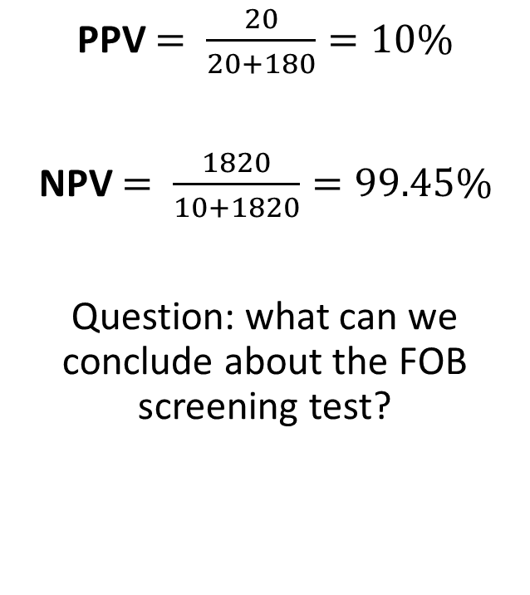
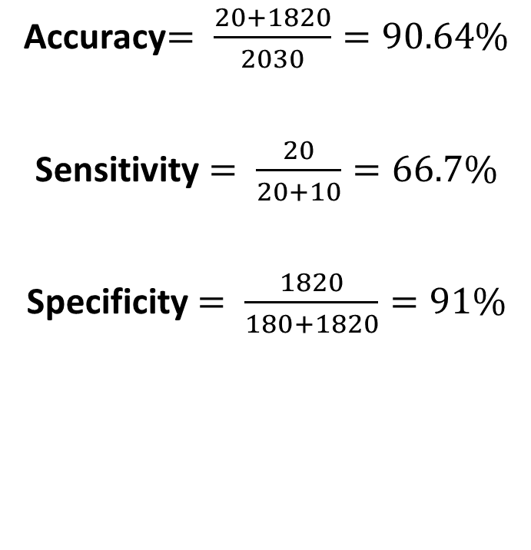
Example: Colon Cancer Screening
Accuracy$= \frac{20+1820}{2030}=90.64\%$
Sensitivity $= \frac{20}{20+10}=66.7\%$
Specificity $= \frac{1820}{180+1820}=91\%$
PPV $= \frac{20}{20+180}=10\%$
NPV $= \frac{1820}{10+1820}=99.45\%$
Question: what can we conclude about the FOB screening test?

Slide 10
Example: Colon Cancer Screening
Many FOB positive results are false positives (confirmed by endoscopy), PPV = 10%
On the other hand, since NPV = 99.45% we can have high confidence in a negative FOB result (specificity = 91%)
Patients who test positive with FOB should follow up with endoscopy to confirm diagnosis

Slide 11
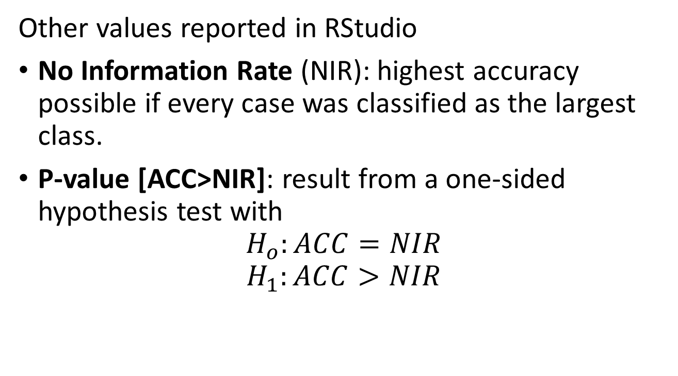
Assessing Classifier Performance
Other values reported in RStudio
No Information Rate (NIR): highest accuracy possible if every case was classified as the largest class.
P-value [ACC>NIR]: result from a one-sided hypothesis test with
$$H_{o}:ACC=NIR$$
$$H_{1}:ACC>NIR$$

Slide 12
Recap: Regression & Classification
 | Classification | Regression
Dependent variable | Discrete values | Continuous values
Nature of dependent variable | Unordered | Ordered
Model fit | Measure accuracy | Measure root mean square error
Algorithm | Logistic Regression | Linear Regression

